Slide 1
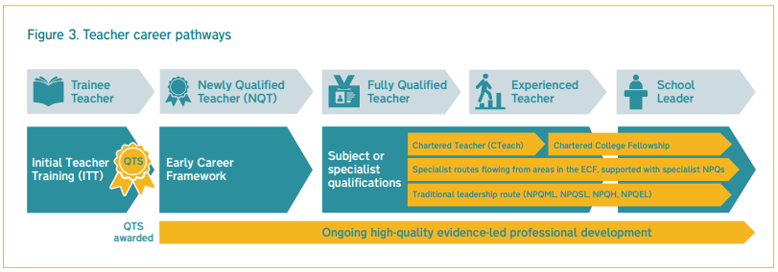
Saffron Teaching School Hub
Details - click here

Slide 2
Introduction
The NQT induction has changed. Since September 2021, it has become two years.
Why?
Surveys show that by one in six new teachers leave the profession after only one year; one in three have left within five years of qualifying.
The learning curve is steepest during the early years of teaching so the plan is to provide improved support for Early Career Teachers (ECTs).
The DfE references the training that is undertaken in other ‘esteemed professions’ (e.g. medicine and law) and the support that those seeking a career in those areas receive in order to become a professional.
“The Early Career Framework (ECF) underpins an entitlement to a fully-funded, two-year package of structured training and support for early career teachers linked to the best available research evidence. The package of reforms will ensure new teachers have dedicated time set aside to focus on their development.
Our vision is for the ECF to build on high-quality Initial Teacher Training (ITT) and become the cornerstone of a successful career in teaching.” *
*Early Career Framework, January 2019
Contents

Slide 3
National Roll-Out
Reforms to the ECF rolled out nationally from September 2021.
Changes to statutory induction arrangements from September 2021
ECTs will undertake 2 years of extended support and training, supported by the Appropriate Body and HT.
ECTs in their second year of teaching are entitled to 5% of time away from the classroom.
ECTS who have started but not completed induction on 1 September 2021 will have until September 2023 to complete a one-year induction period. After this point, these teachers will still be able to complete induction, but will need to complete a full 2-year period.
Qualified Teacher Status (QTS) will continue to be awarded:
at the end of Initial Teacher Training
before the start of statutory induction (minus assessment only route exemptions)
Contents

Slide 4
Delivery of the ECF
All early career teachers will access a programme of training based on the Early Career Framework. Every Head Teacher and Appropriate Body providing statutory induction will need to ensure they meet these new requirements.
There will be 3 approaches available to enable the delivery of an Early Career Framework-based induction. The approaches are:
a funded provider-led programme offering high-quality training for early career teachers and their mentors alongside the professional development materials
schools drawing on the content of the high-quality professional development materials to deliver their own early career teacher and mentor support
schools designing and delivering their own Early Career Framework-based induction programme, based on the Early Career Framework
Action: Decide on your delivery model for an Early Career Framework-based training programme.
Note: approaches 2 and 3 must be fidelity checked by the Appropriate Body
We strongly recommend that you choose the Funded Induction programme.
Contents

Slide 5
What will the ECF look like?
There are 5 key elements to the ECF:
1
2 years of new, funded, high quality training for ECTs and mentors
2
freely available high quality development materials based on the Early Career Framework
3
additional funding for 5% time away from the classroom for teachers in their second year
4
a dedicated mentor and support for these mentors
5
funding to cover mentors’ time with the mentee in the second year of teaching
Contents

Slide 6
The Role of the Appropriate Body
The appropriate body will continue to play an important role in Early Career Teachers’ inductions.
Appropriate Body Roles:
compliance checks to ensure statutory induction entitlements of early career teachers are met assessment verification based on individual headteachers’ recommendations ensure that all Early Career Teachers have access to an ECF-based induction
Appropriate Body Status will be held by:
Teaching School Hubs
Local Authorities
Action:
Register your ECT(s) with an Appropriate Body to fulfil statutory induction requirements.
Contents

Slide 7
Mentoring
All early career teachers will be entitled to a dedicated mentor, who will share their expertise. Mentors will be trained and have access to resources developed by the ECF providers. This role should be separate to that of the induction tutor.
Mentors will receive:
Funded training over the two-year induction period of the ECF; support through high-quality resources; funded release time to work with the early career teacher during their second year of teaching.
If a mentor has more than one Early Career Teacher to supervise, their training allocation can be used by a prospective mentor, with a view to building mentor capacity in the school.
Action:
Identify potential mentors from the existing staff of your school. Who has the skills and experience necessary for this role?
Contents

Slide 8
The Five Core Areas of the ECF
The ECF has been designed to support Early Career Teacher development in five core areas. These relate to the Teachers’ Standards, but are not exactly the same.
Behaviour Management
High Expectations (S1)
Managing Behaviour (S7)
Pedagogy
How Pupils Learn (S2)
Classroom Practice (S4)
Adaptive Teaching (S5)
Curriculum
Curriculum (S3)
Assessment
Assessment (S6)
Professional Behaviours
Professional Behaviours (S8)
The ECF should not be used as an assessment framework, and assessment should only be made against the Teachers’ Standards.
Contents

Slide 9
‘Learn that…’ and ‘Learn how to…’
Each learning section is split into two in the ECF.
The first part is labelled ‘Learn that…’ and asks that teachers new to the profession expand their knowledge and experience of each area.
The second part is labelled ‘Learn how to…’ and details tasks that are designed to be more actionable.
An example is shown on the next slide.
‘Learn that…’ statements are informed by the best available educational research, with references and further reading provided.
‘Learn how to…’statements are drawn from the wider evidence base including both academic research and additional guidance from expert practitioners.
Contents

Slide 10
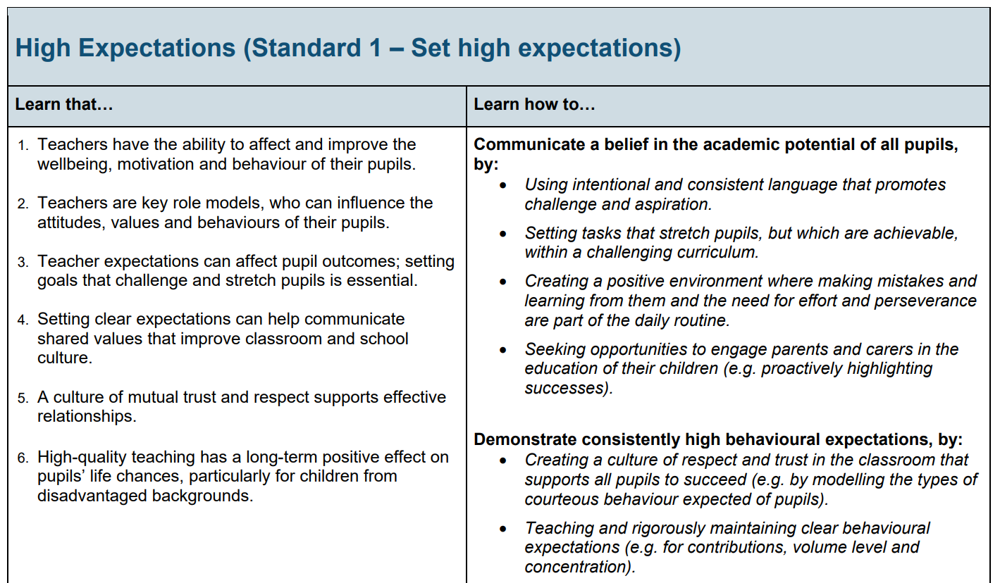
Contents

Slide 11
Early Career Professional Development Programme
Delivery partner –
WHY Saffron Teaching School Hub?
Expert facilitator team made up of local teachers
Local delivery model responds to local contexts
Recognises ECTs and mentors’ need for networks
Experienced and knowledgeable delivery team

Slide 12
Early Career Professional Development Programme
Lead provider –
WHY EDT?
Content is well pitched to enable mentors to build on ITT content in response to their ECT’s needs
Instructional coaching model supports relevant target setting
Uses mentors’ expertise to move between facilitative and directive coaching in response to their ECT’s needs
EDT value feedback and are committed to improving their platform

Slide 13
ECPDP mentors
Considerations for schools:
The CCF and the ECF are almost identical
IT trainee and ECT mentors are likely to be from the same pool of teachers
Mentor development is part of the programme (as it is for ITT)

Slide 14
Call for Facilitators
Local cohorts to be led by local facilitators; each district to have a lead facilitator
Currently facilitator team mainly drawn from leaders of ITT – looking for both more expert facilitators and more developing facilitators
Will receive facilitator training
Facilitator commitment – flexible
Your school will be remunerated at a fixed SLE rate

Slide 15
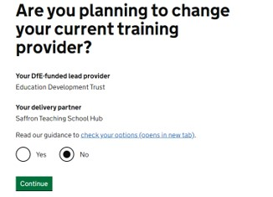
Registration for September 2022 ECTs For schools who already have ECTs doing the Saffron Early Career programme
All schools are now in the process of organising their staffing for next year including recruiting Early Career Teachers (ECTs). Essentially, there are two stages:
Register on the DfE Online Service (opens on May 10th)
To complete the registration process for September 2022 start ECTs, the
Induction Tutor should log in to the DfE Online Service using their existing login
details and then:
Confirm that you do not wish to change your current training provider
Enter the names, TRNs and email addresses of your September 2022
start ECTs and mentors
2) Register with an Appropriate Body
Note that this is a separate process from DfE registration and you should contact the Appropriate Body directly.

Slide 16
Registration for September 2022 ECTs For schools new to the Saffron Early Career programme
All schools are now in the process of organising their staffing for next year including recruiting Early Career Teachers (ECTs). Essentially, there are two stages:
1) Register on the DfE Online Service (opens on May 10th)
Enter the name and email address of your Induction Tutor
Enter the names, TRNs and email addresses of your September 2022 start ECTs and mentors
Choose the Funded Induction Programme (FIP)
Choose Education Development Trust (EDT) as your Lead Provider; you will be directed to their website where you choose Saffron TS Hub as your Delivery Partner
2) Register with an Appropriate Body
Note that this is a separate process from DfE registration and you should contact the Appropriate Body directly.

Slide 17
Saffron Teaching School Hub
Contacts
Doug Brechin (Director) dbrechin@swchs.net
Angela Cass (Early Career Lead) acass@efspt.org
Martin Green (ECPDP administrator) mgreen@efspt.org
Website: saffronteachingschoolhub.net

Slide 18
Saffron Teaching School Hub
Contact
Doug Brechin (Director) dbrechin@swchs.net
Lorraine Chedzoy (NPQ administrator) lchedzoy@swchs.net
Website: saffronteachingschoolhub.net

