Slide 1


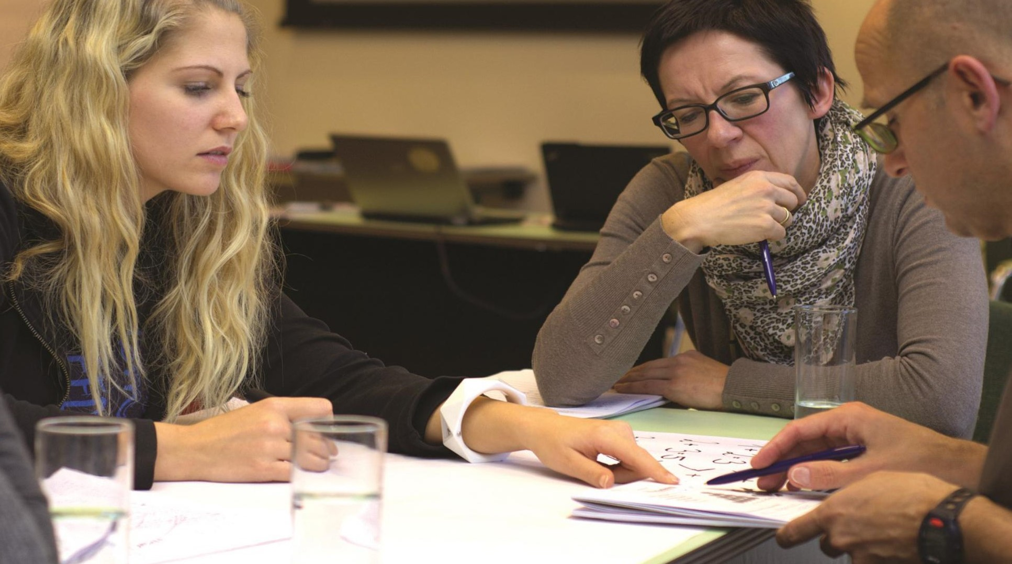
Mentor Conference
Wednesday 24th February 2021
4:00-5:30pm
"Colleagues are a wonderful thing, but mentors, that is where the real work gets done" Junot Diaz
Hosts:
Angela Rodda
Saffron Teaching School Hub
Mark Beyer-Woodgate
Chafford Hundred Teaching School Hub

Slide 2
Mentor Conference
Introduction: Angela Rodda and Mark Beyer-Woodgate "Colleagues are a wonderful thing, but mentors, that is where the real work gets done" Junot Diaz
Keynote 1 - Prof Sam Twiselton OBE: 'Ensuring progression across the frameworks (ITT, ECT, ECF and beyond)’
Keynote 2 - Prof Caroline Daly: ’Learning partners in educative mentoring: principles and practice’
Breakout rooms to discuss Caroline's reading/session and implications for mentor practice
Emma Day: 'Trauma practice in Covid times’
Kelly Campbell, Jane Coleman and Angela Rodda: 'Getting the most out of the mentor meeting’
Emma Hollis and James Coleman: NASBTT Teacher Educator and Mentoring Zone
Opportunity for Q&A: Angela Rodda and Mark Beyer-Woodgate

Slide 3

'Ensuring progression across the frameworks.
(ITT, ECT, ECF and beyond)
Prof Sam Twiselton
Director of Sheffield Institute of Education
Chair DfE ITT Core Content Group
Vice President of CCT
s.twiselton@shu.ac.uk
@samtwiselton

Slide 4

The teacher development journey
Recruitment and Retention
ITT CCF and ECF and the Central Role of Mentors
Policy Development

Slide 5
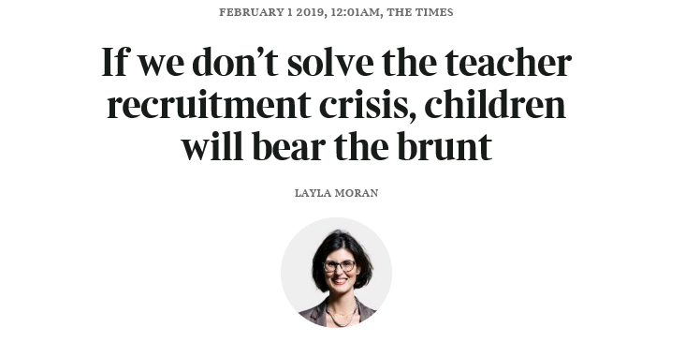


Slide 6




Slide 7

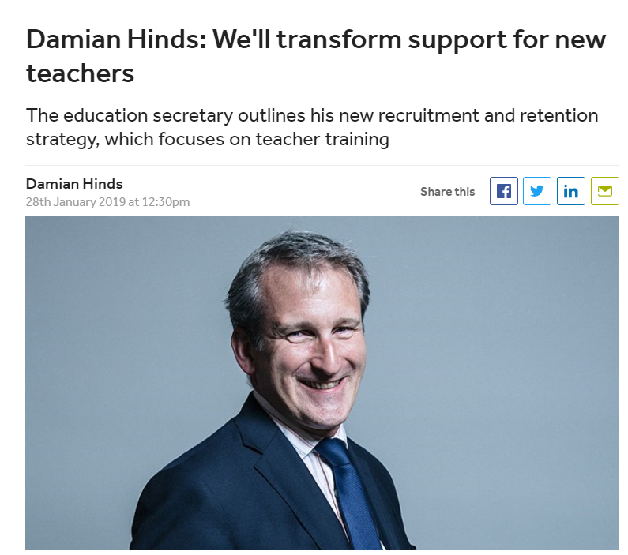


Slide 10
The teacher development journey
My research
Policy Development
Recruitment and Retention

Slide 11
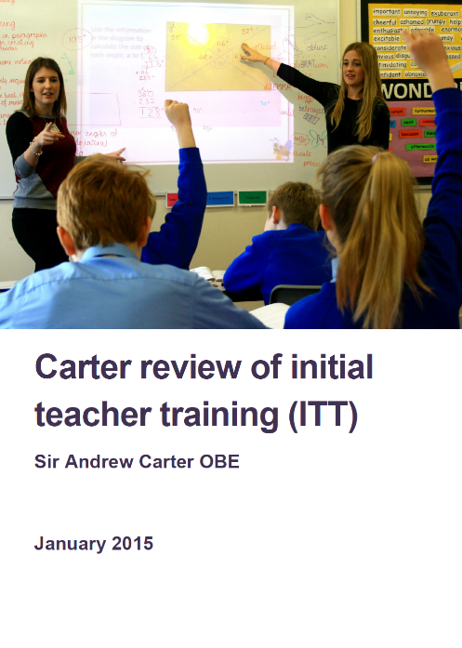
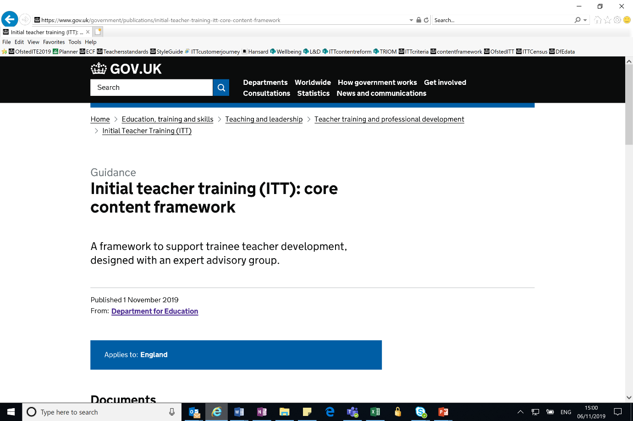



A Short History of Teacher Development Policy

Slide 12
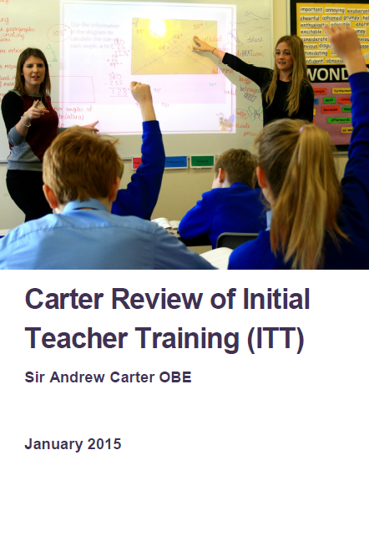
The scope of the Carter Review of ITT
All ITT routes (HEI, SCITT, School Direct as well as Teach First) and subjects/phases.
The Advisory Group
  Professor Samantha Twiselton (Sheffield Hallam University)
  Dr Louise Walker (Manchester University)
  Sir Dan Moynihan (Harris Federation)
  Judith O’Kane OBE (Bright Futures Education Trust)
  Daisy Christodoulou (ARK Schools)
The Review Process
    A review of the existing evidence base
    A call for evidence that received 148 responses
    11 themed roundtable discussions with sector experts
    24 meetings and discussions with experts and stakeholders
    31 visits to ITT providers and schools involved in ITT
    A review of course materials from ~150 programmes.
    A survey of trainee and applicant opinions about ITT course information

Slide 13

Notes from Subject Knowledge Round Table = 11 pages - similar for all the others

Slide 14

REFLECTIONS ON CARTER/ITT framework
The review found a lot of very good practice BUT:
An inconsistent picture as to what is included and how it is delivered
  The best carefully craft and integrate types of knowledge and experiences HOW, WHO, WHERE, WHEN and HOW OFTEN as important (if not more) than WHAT
  Some MATs and TSAs create a seamless join from ITE to NQT/RQT but this is variable regionally and nationally
  The system is fractured nationally and regionally - coordination is lacking systemically
ITE IS NOT LONG ENOUGH AND NOT SUFFICIENTLY JOINED TO EARLY CAREER SUPPORT

Slide 15
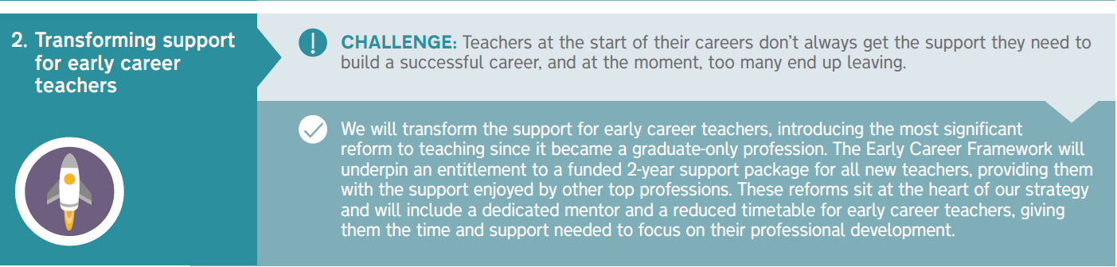
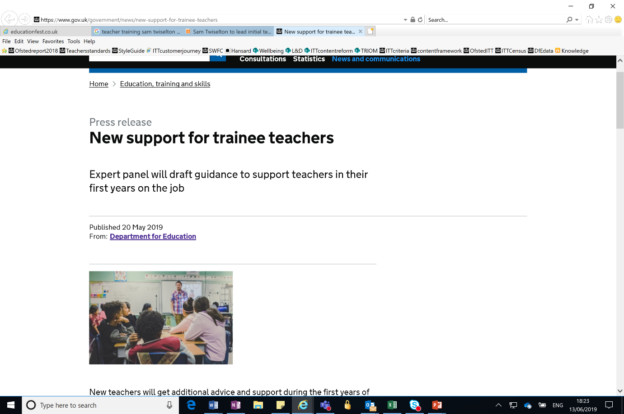

Slide 16

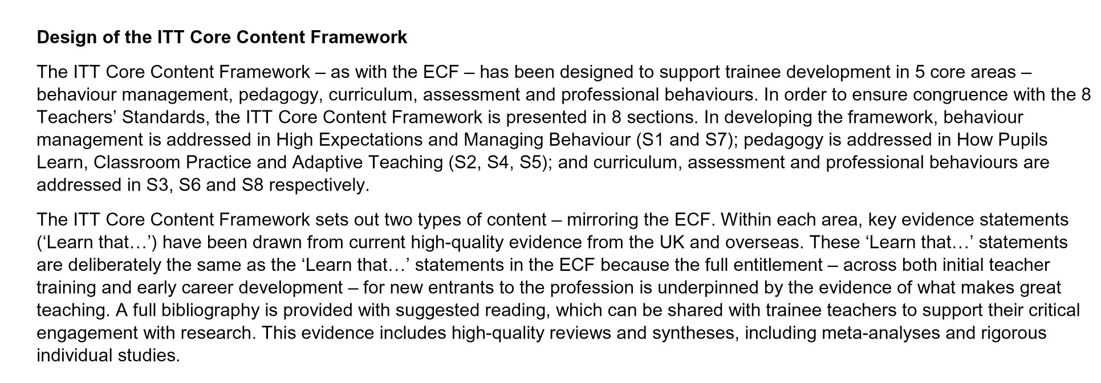
Understanding what it is and what it isn’t
READ IT!
https://www.gov.uk/government/publications/initial-teacher-training-itt-core-content-framework
Notes:
Possible discussion on the layout and content of framework

Slide 17

Aims of the ITT Core Content Framework
A core minimum entitlement.
To work coherently with the ECF to ensure all new teachers benefit from at least 3 years of evidence-based training, across ITT and into induction.
To support more trainees to successfully enter and remain in the profession.

Slide 18
Early anecdotal impressions
The ‘framework not curriculum’ message needs emphasizing but is then welcome
Sequencing and crafting of experiences is key
Some terminology is less familiar but benefits from critical analysis and relating to more familiar models
The ‘expert colleague’ term needs unpacking but this prompts a useful conversation (see next slide)
Covid has clearly thrown up many challenges but also some opportunities

Slide 19
Expert Colleagues: illustrative examples
ITE tutor
Pastoral lead
SENCO
HoD/subject leader
DHT Teaching and Learning
DHT Curriculum
TSA Lead for x
MAT lead for y
Dissertation supervisor

Slide 20

The many moving parts of R+R

Slide 21
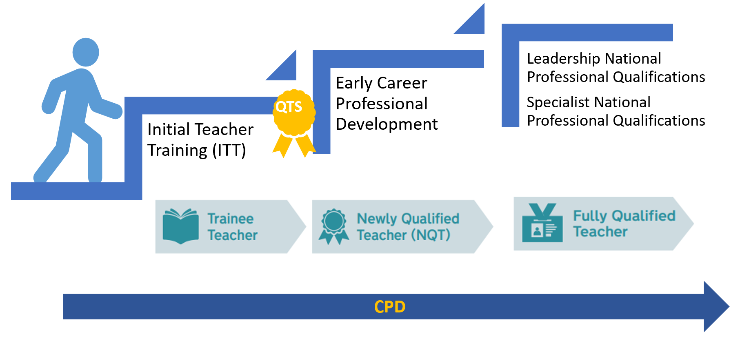

Slide 22
Reformed Suite of NPQs
Section map showing how professional development is a thread between all the new NPQ frameworks
Leading Teacher Development
Teaching (Consolidation of ECF)
Designing Professional Development
Delivering Effective Professional Development
Implementation
Leading Teaching
Teaching (Consolidation of ECF)
School Culture
How Pupils Learn
Subject and Curriculum
Classroom Practice
Adaptive Teaching
Assessment
Professional Development
Implementation
Leading Behaviour and Culture
Teaching (Consolidation of ECF)
School Culture
Enabling Conditions for Good Behaviour
Complex Behavioural Needs
Professional Development
Implementation
Senior Leadership/ Headship/Executive Leadership
Culture
Teaching
Curriculum and Assessment
Behaviour
Additional and Special Educational Needs and Disabilities
Professional Development
Organisational Management
Implementation
Working in Partnership
Governance and Accountability

Slide 23

Who is it for?
Teachers who currently have or are aspiring to have responsibilities for leading the development of other teachers in their school
Likely to be part of the middle leadership team (but roles vary)
May manage a team of mentors or coaches (directly or indirectly)
Primary or secondary
Working in any type of school (including special schools)
Role may include supporting:
- trainee teachers (ITT)
- early career teachers (ECF)
- and/or wider development of
school colleagues
Teacher
Developer

Slide 24
Questions and comments
There will be an opportunity at the end of today’s conference to post your questions.

Slide 25

Learning partners in educative mentoring: principles and practice
Caroline Daly
Professor of Teacher Education
UCL Institute of Education

Slide 26
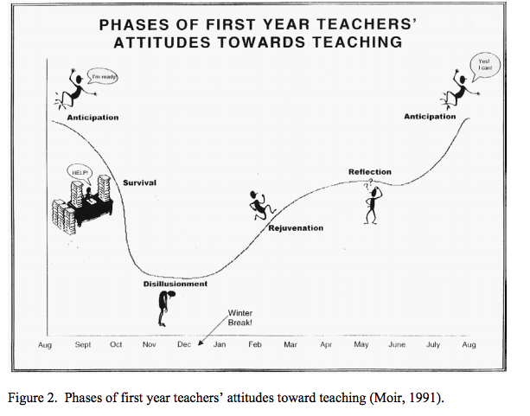
Moir, 1999

Slide 27

Mentoring in a dual role
Programme tasks
Enquiring
Taking risks
Thinking critically
Learning over time
Assessing
Developing
Standards
Accountability
Student & pupil outcomes
Learning conversations

Slide 28
Vital: balancing support and challenge
Confirmation
Pre existing images become reality
Growth
Growth through development of new knowledge and images
high
Support
low
Challenge
high
Stasis
No encouragement to consider or reflect on knowledge or images
Retreat
Withdrawal from mentoring and no possible growth
low
After Martin (1966), Daloz (1986)

Slide 29


How is the mentor role understood?
Expert-novice
Learning partners

Slide 30


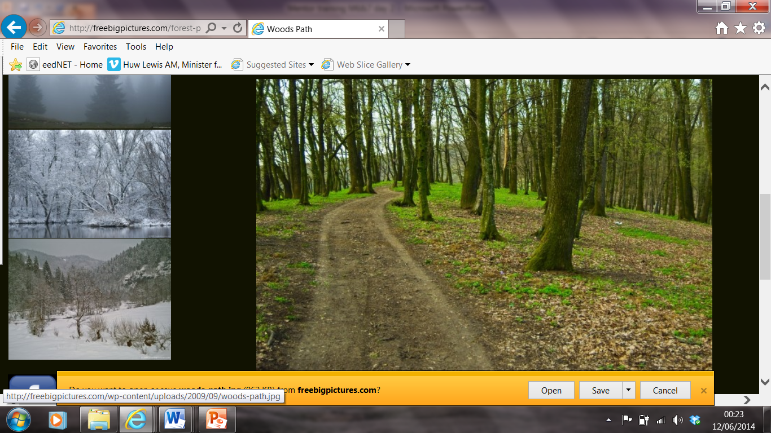
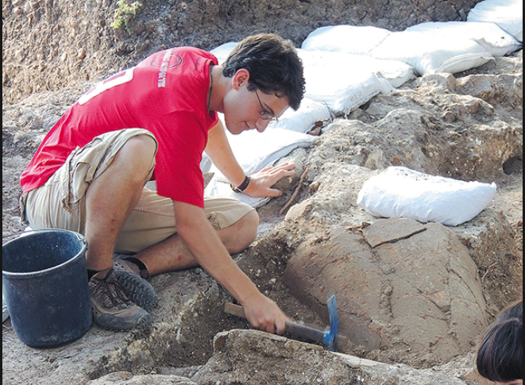
Which image strikes you as most representing the mentoring relationship
with a student/trainee teacher?

Slide 31
Some reflection…
Would the same picture represent your own experience of being mentored as a new teacher?
What pictures do you think student/trainee teachers would choose to represent how they see the mentoring relationship?

Slide 32
I haven’t discussed my end of ITE progress review with my NQT mentor – is it too late? Is there any point?
What’s all this about joining a Subject Association or specialist phase association? Do I have to pay for that?
Will I be able to co-plan my lessons with my mentor?
I’ve got QTS ‘on trajectory’ – am I expected to be able to do all the things normally expected of a NQT?
I’m really struggling with this class. The things I’ve been advised to try don’t seem to be working. What next?
I’m finding it really hard to manage my workload. I know that’s what teaching is like – I can’t see any way of dealing with this?
Sometimes I think it shows that I did little class teaching before schools closed last year. How can I admit this?
I thought observing other teachers would help my development – this doesn’t seem to be happening?

Slide 33

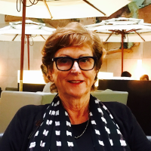
Research into mentor-mentee relationships
NEW TEACHERS
MENTORS
Hobson and McIntyre (2013)
‘Teacher fabrication as an impediment to teacher learning and development’
Proposes intrinsic challenge in the dual role of mentor = fabrication
Risks of ‘judgementoring’ (Hobson & Maldarez, 2013)
Langdon (2014)
Mentor/mentee learning conversations
New Zealand – trainee teachers & NQTs
Mentor research – did not really know the kinds of dialogue they practised
Identified types of dialogue/ examined conversations
Mentor development

Slide 34
The necessity of mutual purpose
strategic avoidance
No one wants to expose their weakness … I can openly admit when I started at this school that I wouldn’t go to anyone
You never want to mention any potential failings that you might have to your mentor or your line manager ... I have got the acting down to a fine art
FABRICATION
strategic silence

Slide 35
Educative mentoring …
…is based on a vision of teachers as learners and the classroom as a site of enquiry (Norman and Feiman-Nemser, 2005)…

Slide 36
…It is based on collaborative principles that involve building knowledge together about teaching and learning (Daly and Milton, 2017)

Slide 37
…facilitating the development of alternative beliefs and viewpoints (Flores and Day, 2006) –

Slide 38
…and collecting and assessing high-quality evidence that is professionally relevant to the [beginning] teacher (Yusko and Feiman-Nemser, 2008).

Slide 39
Teachers as learners
Collabor-ation
High quality evidence
Developing beliefs
Alternative viewpoints & critical thinking
Classroom enquiry, reading, reflection
Co-planning, team-teaching, post-lesson dialogue
Classrooms as sites of enquiry

Slide 40
Educative Restrictive
‘a role, a relationship and a process’
Enquiry into pupil learning as basis for practice development
Mentor learning as well as student/NQT learning
Learning from ‘experts’
Passing on school routines and norms
‘how things are done around here’

Slide 41
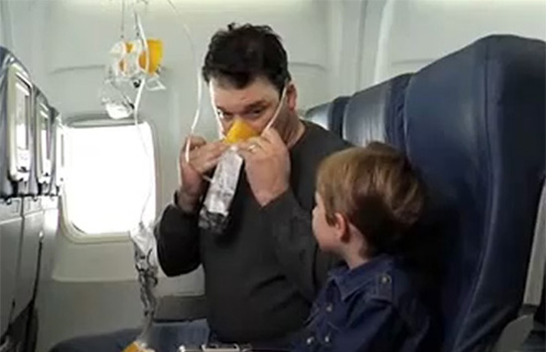

Slide 42
Policy environment
Educative mentoring
Concerned with identifying ‘what works’
Concerned with finding solutions to problems
Concerned with replicability and reliability across contexts
High emphasis on data demonstrating compliance
Conceptualises knowledge as stable and transferable
Seeks certainty
Concerned with the teacher as a social, principled, practitioner
Concerned with problematising practices
Concerned with classrooms
as highly complex social spaces
High emphasis on rich data as evidence of teacher learning
Conceptualises knowledge as constantly reconstructed
Embraces uncertainty as core to thoughtful teaching

Slide 43
This means
‘A new mentoring stance’ (Langdon and Ward, 2015)
The quality of dialogue is crucial
‘alternative practices’ are explored
Planning and reviewing teaching are core
Enquiry is embedded – ‘let’s find out…’
Builds capacity for school improvement

Slide 44
Break out groups
Educative mentoring – deepening understanding
What can we do to stop so many pupils in this class ‘falling off a cliff’ when we’re teaching fractions, once we move from teacher-led input to pupil practice?
How could we work with pupil voice to help design our new topic next term?
Could the ‘curiosity corner’ be better used to support learning in science this term?

Slide 45
Break out groups
Think of an educative question worth exploring with a mentee
  What could the mentee learn?
  What could the mentor learn?
  What could be the impacts on the pupils/students?
  What kinds of evidence might be generated by pursuing this question?

Slide 46
Daly, C and Milton, E. (2017) “External Mentoring for new teachers: mentor learning for a change agenda”, International Journal of Mentoring and Coaching in Education, 6(3) 178-195.
Flores, M. and Day, C. (2006) “Contexts which shape and reshape new teachers’ identities: a multi-perspective study”, Teaching and Teacher Education, 2, 219-232.
Hobson, A. and Malderez, A. (2013) Judgementoring and other threats to realizing the potential of school-based mentoring in teacher education. International Journal of Mentoring and Coaching in Education, 2 (2), 89–108.
Hobson, A. and McIntyre, J. (2013) “Teacher fabrication as an impediment to professional learning and development: the external mentor antidote”, Oxford Review of Education, 39(3) 345-365.
Langdon, F. (2014) “Evidence of mentor learning and development: an analysis of New Zealand mentor/mentee professional conversations”, Professional Development in Education, 40(1) 36-55
Langdon, F. and Ward, L. (2015) “Educative mentoring: a way forward”, International Journal of Mentoring and Coaching in Education, 4(4) 240-254.
Moir, E. (1999) The stages of a teacher’s first year. In M. Scherer (Ed.), A better beginning: Supporting and mentoring new teachers, 19–23. Alexandria, VA: Association for Supervision and Curriculum Development.
Norman, P.J. and Feiman-Nemser, S. (2005) “Mind activity in teaching and mentoring”, Teaching and Teacher Education, 21, 679-697.
Yusko, B. and Feiman-Nemser, S. (2008) “Embracing contraries: combining assistance and assessment in new teacher induction”, Teachers College Record, 110(5) 923-953.

Slide 47
Trauma and mental health: the impact of Covid-19
Emma Day
BA(hons) QTS, PGDip (psych), NPQH, FHEA, MBACP

Slide 48
Aims for the Session
To understand the impact of trauma on the brain
To be able to have successful mentoring conversations during this time

Slide 49
What is Trauma?
Going through very stressful, frightening or distressing events is sometimes called trauma. When we talk about emotional or psychological trauma, we might mean:
situations or events we find traumatic
how we are affected by our experiences
Traumatic events can happen at any age and can cause long-lasting harm. Everyone has a different reaction to trauma, so you might notice any effects quickly, or a long time afterwards. (Mind, 2021)

Slide 50
An introduction to Trauma
“Trauma, including one-time, multiple, or long-lasting repetitive events, affects everyone differently. Some individuals may clearly display criteria associated with posttraumatic stress disorder (PTSD), but many more individuals will exhibit resilient responses or brief subclinical symptoms or consequences that fall outside of diagnostic criteria. The impact of trauma can be subtle, insidious, or outright destructive.”
(NCBI,2014)
Reactions are a normal response to an abnormal situation
Notes:
Emma

Slide 51
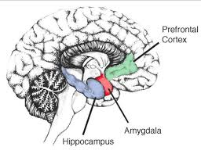

Traumatic Stress
Immediate and delayed responses: refer to handout 1
Spotting the immediate signs…. But why?
Effect of trauma on the brain

Slide 52
Mentoring conversations that support in times of trauma
Avoid trying to fix the problem. During times of trauma most people feel out of control. If you try to fix this, it can lead to further feelings of not managing or failure.
Coaching and therapeutic approaches (based on a solution focussed approach)
This approach puts the trainee in the driving seat and avoids mentor burnout.
Handout 2

Slide 53
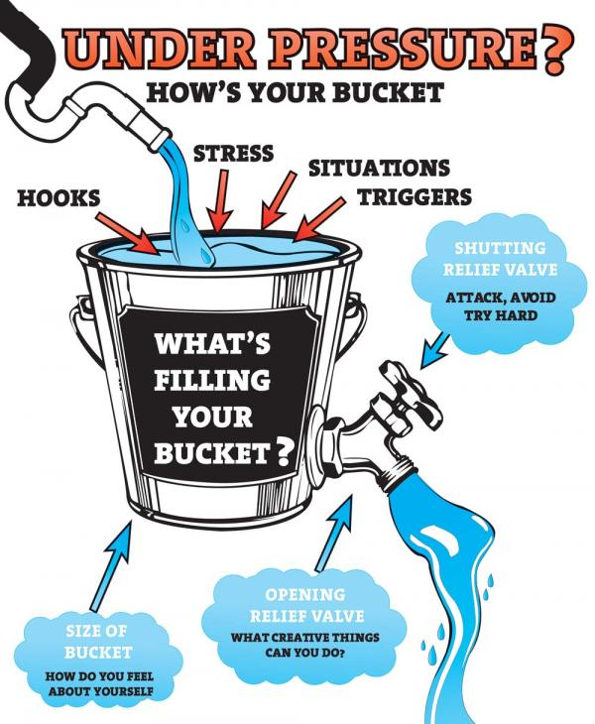
The Stress Bucket

Slide 54
Case Study
Trainee A declared medicated anxiety, she was diagnosed with EUPD. This was being managed. However, during lockdown she had started to hear voices. She is in a school that may also be a stressful environment.
In initial interview was held to discuss triggers and strategies.
A mental health support plan was drafted with her.
Regular monitoring is in place.
Her Tutor receives regular supervision.
Sometimes the support is less than you imagine…..

Slide 55
Nature of Needs (please comment and link to the Teaching Standards or Code of Conduct where appropriate):
Major anxiety, struggling with sleep. With lectures this has given a sense of routine. I was in a dark place a couple of months ago. Sertraline 100mg, was on 50mg for 1month then increased about a month ago. My paranoia has eased but I have self doubt. I worry that I'm rubbish at what I'm doing, others talking about me/laughing about me. I have had voices (in the past). This is ok at the moment. I now have thoughts that feel more like worry: am I going to be a good enough teacher? I've been hiding my anxiety and depression for a long time. Lockdown got to me. It went downhill. I couldn't get out of bed and attached to myself to my mum. If I got out of bed I needed to know where she was, I wasn't eating or talking to anyone. I then started going out on walks. Then I would come home and go straight back into my room. This is a blessing in disguise. I'm now getting the help I need. I was a zero then, now an 8 (out of 10). This week has been overwhelming. Before I would have avoided doing things, however this has not happened. I feel more organised. I feel this is because this is where I want to be (teacher training). The number that feels unmanageable is 5.

Slide 56
Useful strategies for home | Person Responsible | Monitored by
Staying organised and on top of my workload - supports my wellbeing | Trainee | Tutor
Liaising with XXX when I feel my number dropping below 6 (this is a scale of 0-10) | Trainee and WBL | WBL
Self monitoring on a scale of 0-10. Promptly contacting ED as above. | Trainee | WBL
XX has a counsellor and can increase the sessions if she needs to. | Trainee | WBL
Useful strategies for lectures | Person Responsible | Monitored by
Staying organised and on top of my workload - supports my wellbeing | Trainee | Tutor
Be engaged with the study group as a means of support. | Study group. | Tutor

Slide 57
Useful strategies for school | Person Responsible | Monitored by
Feedback to focus on what went well. For XXX to begin to reflect on what went well. For SMART targets to be set for development ensuring these are monitored and adjusted if need be. | Class mentor and PT: Tutor | Tutor
Trainee to email WBL if feedback feels unmanageable or focusses on negative rather than the positives. Trainee is aware the feedback should focus on what she is doing well with small targets set for improvement. | Trainee | WBL
Standing in front of the class for the first time is a concern. The gradual build up to this was explained. The gradual build up will be essential: small group work , then register, then story, then lining children up, then a small starter to a lesson. | XX has already discussed with her mentor team teaching. | Class mentor
Share this document with the school. | XX will print and ensure the document is shared but not left in school. | Tutor

Slide 58
Trainee’s views
I came to this meeting just wanting to know that I had the extra support.

Slide 59
On-going support for trainees and mentors during this period (whilst working with on-going trauma)
Observations and meetings to have a specific foci
Meetings to be short
Personal reflections /observing expert colleagues - can these be scaffolded?
Instructional coaching (builds on the positive solution focused approach)
Carefully designed coherent curriculum...lectures/taught course to link to practice
Mentor liaison (supervision)
Trainee peer support

Slide 60
Finally a steer from Professor Barry Carpenter, CBE, OBE, PhD, FCCT:
“Teaching is about relationships” so when entering the classroom in September new teachers should “ go in humanity first and teaching second”

Slide 61
Your Homework
Draw your own stress bucket

Slide 62

Effective mentoring: making the most of our valuable time
Notes:
Welcome /Intros 2 mins Angela

Slide 63
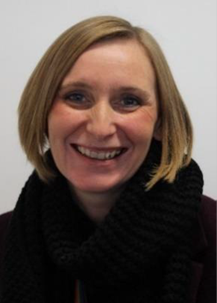

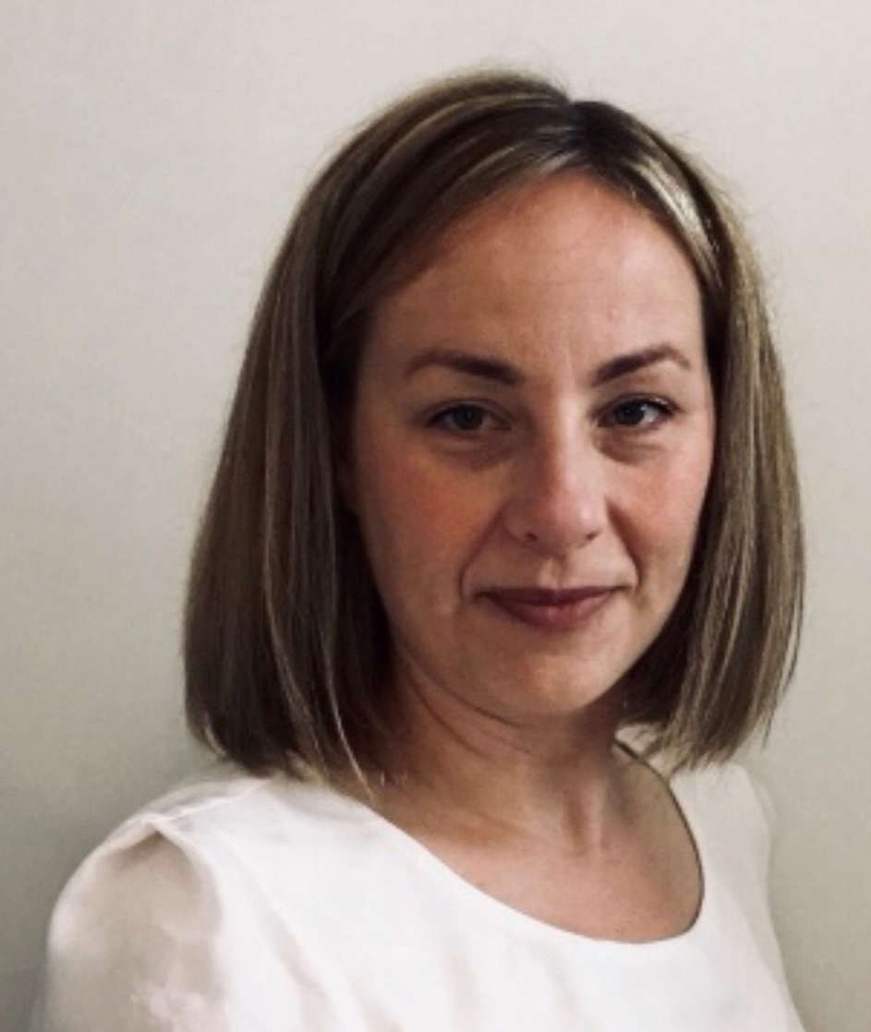
Who we are
Why we are interested in this work with mentors
  Angela Rodda - Lead on ITT for the Saffron Teaching School Hub -
  based at Saffron Walden County High School - Assistant
  Director of CTSN SCITT
Jane Coleman - Director for Tes Institute’s School Direct Programme
Kelly Campbell - Deputy Director for Tes Institute’s School Direct Programme
Notes:
1 min
Useful for anyone new to teaching, needing to refresh behaviour management or other essential teaching strategies or advice for mentors on how to lead others in improving key teaching skills.
It’s easy to digest, clearly laid out, each walkthru has been backed up by the latest educational research. It covers strategic methods to “engineer professional learning processes” so that they are “effective and sustained”.
All mentors have been given a copy of the book.

Slide 64
Are mentors aware of all the responsibilities and commitments expected of our trainees?
What ITT provider tasks does your trainee have to do each week?
What PGCE or Action Research work do they need to do and how is mapped out?
What are other teachers who are working with your trainee asking them to do? Are you aware of this and monitoring it?
What subject knowledge development tasks are they working on each week? How do we keep this high on the agenda, but make it manageable for them?
When are the pinch points for trainees each term? Can we help with a light duties/reading week?
Could mentors do a 360 view of each term with your trainee and map out commitments so you both have a clear view and can plan for this?
Trainees do not know how to manage their time well - this is something we have to teach them. Using your frees effectively is the best lesson to learn as a new teacher!
How can you support this process by building a timetable that supports all your trainee’s commitments and helps them learn how to manage their time in bite-sized chunks ?
Notes:
Angela
1 min
Useful for anyone new to teaching, needing to refresh behaviour management or other essential teaching strategies or advice for mentors on how to lead others in improving key teaching skills.
It’s easy to digest, clearly laid out, each walkthru has been backed up by the latest educational research. It covers strategic methods to “engineer professional learning processes” so that they are “effective and sustained”.
All mentors have been given a copy of the book.

Slide 65
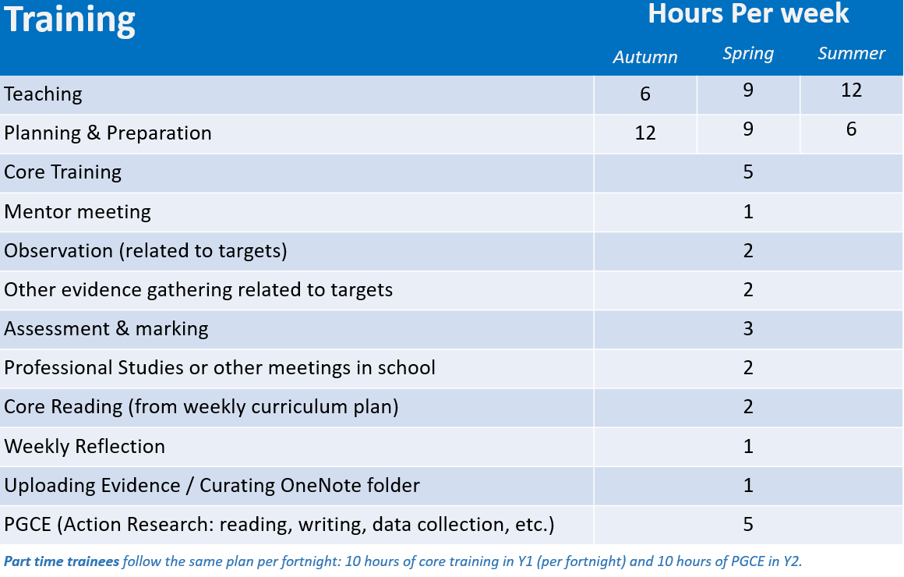
How could designated slots on a trainee’s weekly timetable help support trainees with time management and workload?
Here is an example of what this might look like in practice.
This is based on trainee working a 42-hour week- in school and out of school. This can be amended to suit your trainee, your provider and their unique needs.
How much is the trainee teaching?
What are the ITT provider commitments each week?
We do need to recognise that research, reading and completing other professional activities takes time and build this into the timetable.
PGCE commitments may need time allocated out of school to visit a library or work in a chunk of time independently.
Too much time in school teaching, observing and marking gives very little time for other work. If trainees are then taking all this home, it can make time management and work life balance very difficult.
Too much lesson observation in school that is unfocused can eat into the trainee's week and have limited impact on their progress, if untargeted.
At pinch points could we build in a light duties/reading week?
Notes:
Angela
1 min
Useful for anyone new to teaching, needing to refresh behaviour management or other essential teaching strategies or advice for mentors on how to lead others in improving key teaching skills.
It’s easy to digest, clearly laid out, each walkthru has been backed up by the latest educational research. It covers strategic methods to “engineer professional learning processes” so that they are “effective and sustained”.
All mentors have been given a copy of the book.

Slide 66
Looking at this through the lens of lesson planning
Lesson planning is the single most time consuming thing for a trainee teacher.
Fact - Trainees don’t know how to plan, where to find resources or class information, or what to prioritise.
As mentors, we need to ask ourselves what is the core purpose of making trainees plan a lesson.
It should not be about evidence gathering or box ticking - It should be to enable mentors to support your trainee to learn about effective lesson planning. If you can see how they are thinking about their planning - you can help them improve!
Ask yourself what you are most concerned about when reviewing your trainee’s lesson plan. (For me, it is seeing they understand the big picture thinking on how the lesson plans builds on prior knowledge, what AFL opportunities will be used to test that the learning objectives have been met and that the trainee is clear on what adaptive teaching methods will be employed to support ALL learners.) I am less interested in what happens at 3.03pm or when the glue sticks get handed out.
As mentors we make it clearer what the main focus is when planning a lesson. The logistics of the lesson might be seen in the trainee’s PPT, smart file or recorded video demonstration/worksheet. Does this all need to be written out again - if we can already see it in this format?
How much time are we spending co planning with our trainees to help model and speed up the planning process?
This is where the real support/learning happens! 10 minutes doing a draft 5 minute lesson plan overview with your trainee where you give them some lesson resources can save the trainee hours of time going forward. In reality this is how all teachers plan - together!
Notes:
Angela
1min
More teachers are looking to develop their practice harnessing the ideas from cognitive science and other areas of research.

Slide 67

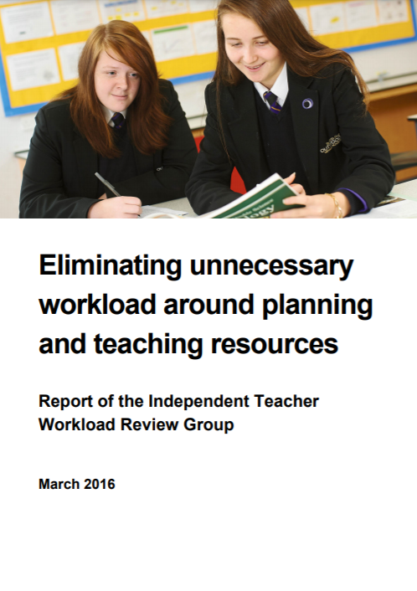
DfE school workload reduction toolkit
We need to think again about our processes and practices:​
remove those that have become established through custom rather than evidence of what works. This is particularly relevant in relation to lesson planning. ​
review our demands on trainee teachers in relation to planning to concentrate on the purpose of planning and how to plan across a sequence of lessons​
reduce the expectation on trainees to develop their own individual lesson plans and curriculum resources for every lesson they teach; instead trainees should focus on evaluating, using and adapting (where necessary) existing high quality resources, schemes of work and textbooks​
Review approach to Curriculum planning at the early stages of teacher training to develop a more structured approach around co-planning.​
encouraging the use of high quality curriculum resources and textbooks to plan a sequence of lessons. As trainees become more secure in their planning, they should be encouraged to evaluate existing resources to assess their quality and make decisions on which are best to use in different contexts;​
Over time, trainees should also be encouraged to develop more light touch planning over sequences of lessons in line with the principles found in the independent report on planning and resources.​
Notes:
Jane
1min
More teachers are looking to develop their practice harnessing the ideas from cognitive science and other areas of research.

Slide 68
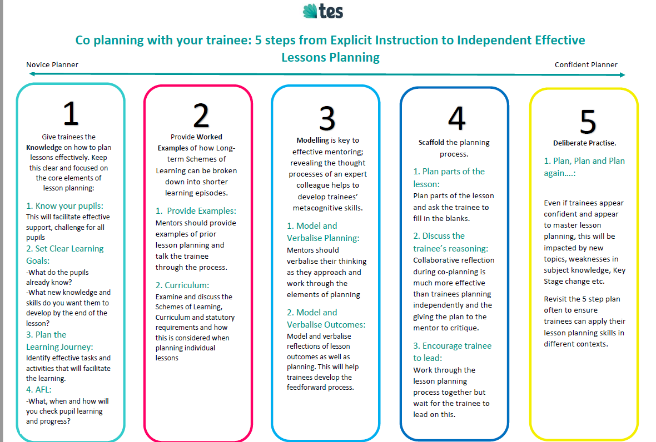
Notes:
Kelly
1min
More teachers are looking to develop their practice harnessing the ideas from cognitive science and other areas of research.

Slide 69
Getting the most out of the hour long mentor meeting
The purpose of the mentor meeting is to look backwards and forwards.
To review the trainee’s learning and progress from last week and set up personalised and clear targets for the following week.
This is formal meeting - much like our line manager meetings. This needs clear expectations, boundaries and time management to make the most of the hour. This is the skill of the mentor!
It requires preparation for both the trainee and the mentor to make it a success.
Notes:
Angela
1min
Not to be confused with traditional coaching with open ended questions, IC is more like sports coaching, where an expert teacher helps the classroom teacher to focus on one aspect of their techniques that can be isolated and practiced.

Slide 70
Getting the most out of the hour long mentor meeting
We can think of the meeting as having distinct phases:
5 mins: Pastoral catch up/ well-being check - We must be strict on this and if needed make another appointment if the trainee flags a pastoral concern. The mentor meeting is not the place for a constant review of how the trainee is feeling. Trainees have to learn the professional conduct expected of such meetings and we have to model this for them.
10 mins: Reviewing trainee targets. What were the trainee’s targets from last week, what have they learnt/completed? Trainees should come prepared with this ready to share. Mentors need to clearly communicate their expectations of this in advance of the meeting.
15 mins: Discussion of last week – review the trainee’s learning. What is the quality of any evidence of progress? What are the lesson observation feedback reports telling us we need to work on? What is the quality of the trainee’s reflection of student progress? Can the trainee articulate to you their strengths and areas to develop from their weekly practice. Is this in line with your thoughts?
15 mins: target setting for next week- This should be based on ITT course requirements and trainee’s personalised learning. How are mentors communicating these targets to other teachers that the trainee is working with?
15 mins: This can be used for modelling & rehearsal of ONE aspect of trainee’s practice. Or could be used for forward lesson planning for next week.
Notes:
Angela
1min
Not to be confused with traditional coaching with open ended questions, IC is more like sports coaching, where an expert teacher helps the classroom teacher to focus on one aspect of their techniques that can be isolated and practiced.

Slide 71
Instructional Coaching approaches to mentoring is designed to do?
Current performance
Target performance
Deliberate practice supported by coaching with precise targets and clear action steps that can be modelled and practised together.
Ericsson and Pool (2016)
Notes:
Angela
1 min
Let’s set the context for Instructional Coaching in terms of how it works.
The goal of coaching is to move teachers on from their current performance in the classroom to improve one aspect of their practice.
This might be ‘I want to improve my questioning’. The role of coaching in this is to provide deliberate practice, which we’ll explore more as we go along, to support this.
These terms are taken from the work of Ericsson and Pool.

Slide 72
So…where it can go wrong?
The trainee is not prepared for the mentor meeting- time is then lost finding evidence of weekly targets. We must make our expectations clear to trainees and encourage preparation.
The mentor is not prepared for the meeting- lesson observation reports from other teachers have not been read, or perhaps the mentor is not clear on the requirements of the course for their trainee. Mentors must prepare for each meeting- It is clear to trainees when this is not the case. Mentors may need support from the ITT provider for this.
The full hour is not given to the trainee. Mentors can be called away for other things. We must protect the mentor meeting time and find a private and safe space to have these sensitive discussions.
The hour meeting is used to discuss teaching and learning in more general terms, but the formal review of targets is not the focus. We all need to realise the importance of well crafted weekly targets and training tasks for scaffolding and assessing trainee learning over time.
The mentor meeting is a pastoral care meeting only. On the odd occasion this may be necessary, but it should not be a pattern. We must make our expectations clear on the purpose of the mentor meeting and the protocols expected. Modelling professional practice.
Notes:
Angela
1min
Not to be confused with traditional coaching with open ended questions, IC is more like sports coaching, where an expert teacher helps the classroom teacher to focus on one aspect of their techniques that can be isolated and practiced.

Slide 73

Dispelling some mentoring myths..
Notes:
1min

Slide 74
Dispelling some mentoring myths
Trainees need to complete detailed lesson plans.
Lesson planning is a process and writing a lesson plan documents that process. Written lesson plans are not a necessity but a tool for practice development. The focus should be on developing effective practice and not minutely detailing every step of the lesson plan and its delivery.
Trainees do not have design original resources, tasks and activities.
Trainees can learn how to adapt already available resources – do not reinvent the wheel. The skill is in how you use and adapt already produced resources that are proven to be effective.
Mentors need to see evidence that the trainee has differentiated their lessons both within their plans and the lesson itself.
‘In-class differentiation, through providing differentiated teaching, activities or resources, has generally not been shown to have much impact on pupils’ attainment.’ ‘adapting teaching in a responsive way, for example by providing focused support to pupils who are not making progress, is likely to improve outcomes… this type of adaptive teaching should be clearly distinguished from forms of differentiation that cause teachers to artificially create distinct tasks for different groups of pupils or to set lower expectations for particular pupils. ‘ (Ofsted, 2019)
Mentors are the ‘Expert Colleagues’ as referred to in the CCF
There is a pool of Expert Colleagues’ that the trainee can learn from in school and the mentor is one. Senior Leaders, SENDCo’s, Support Staff, Heads of Year/Departments, Phase Leaders etc. are experts that the trainee can learn from.
Notes:
Jane
1min
Not to be confused with traditional coaching with open ended questions, IC is more like sports coaching, where an expert teacher helps the classroom teacher to focus on one aspect of their techniques that can be isolated and practiced.

Slide 75

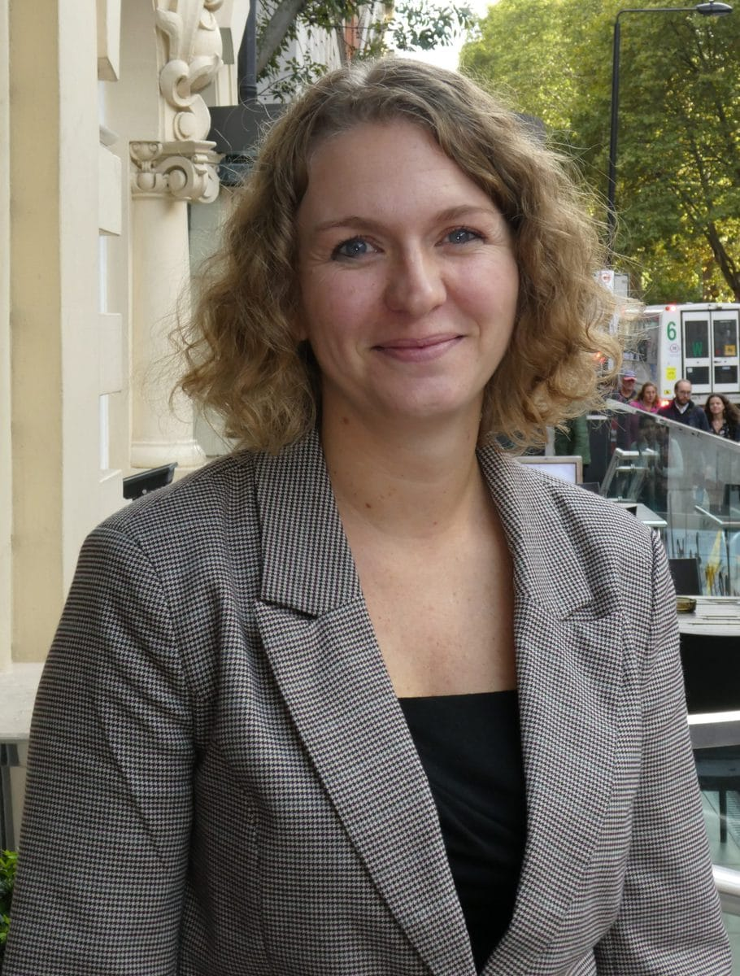

Teacher Educator and Mentoring Zone
The Teacher Educator and Mentoring Zone is dedicated to supporting the professional learning and development of Teacher Educators individually and as a profession.
We believe it is vital to recognise the role of a Teacher Educator as a professional who is instrumental to the development of early career teachers.
https://www.nasbtt.org.uk/temz/
Emma Hollis Executive Director
James Coleman Consultant

Slide 76

Q&A session
Please click on the link in the chat and type your questions directly into our Q&A Google document.
We will collate all your questions and produce an ‘FAQ’ document which we will send out by email after the conference.

